Slide 1

SABIA National Biogas Conference
Charlotte Morton, Chief Executive World Biogas Association
28 October 2021

Slide 2



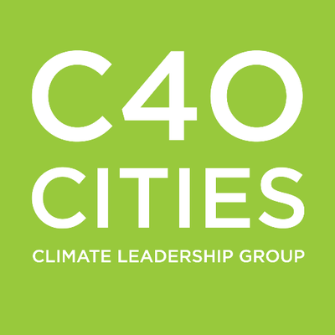






WHO ARE WE?
Founded in 2016 by national associations from the UK, USA and Italy and 20 founding company members
Now represent ~ 100 organisations from around the world, including national associations from Latin America, Asia, Africa and Europe
Observer with UNFCCC, member of CTCN, CCAC, GMI, and a partner of C40 Cities Network
Cooperating with FAO, EU, UNEP, IEA among others

Slide 3
WHY ARE ORGANIC WASTES A PROBLEM?
Over 105 billion tonnes of organic wastes globally
If not recycled, these emit methane and other GHG emissions
Global Methane Assessment by CCAC demonstrated tackling methane is most ‘immediate and cost-effective’ way to keep global warming below 2C
Rice stubble burning, manures, wastes and wastewater, are responsible for ~20% of total methane emissions
Only 2% are treated and recycled

Slide 4
WHY IS FOOD WASTE A PROBLEM?
Greenhouse gas emissions …8% of global emissions
Nutrient loss …52% of agricultural land
Sanitation …13-33% openly dumped
Water footprint …3 times volume of Lake Geneva
Ecological impacts …Intangible
Economic impacts …2.6 trillion dollars
In addition to the ethical argument against food waste, it has an impact on the people, environment and the economy

Slide 5
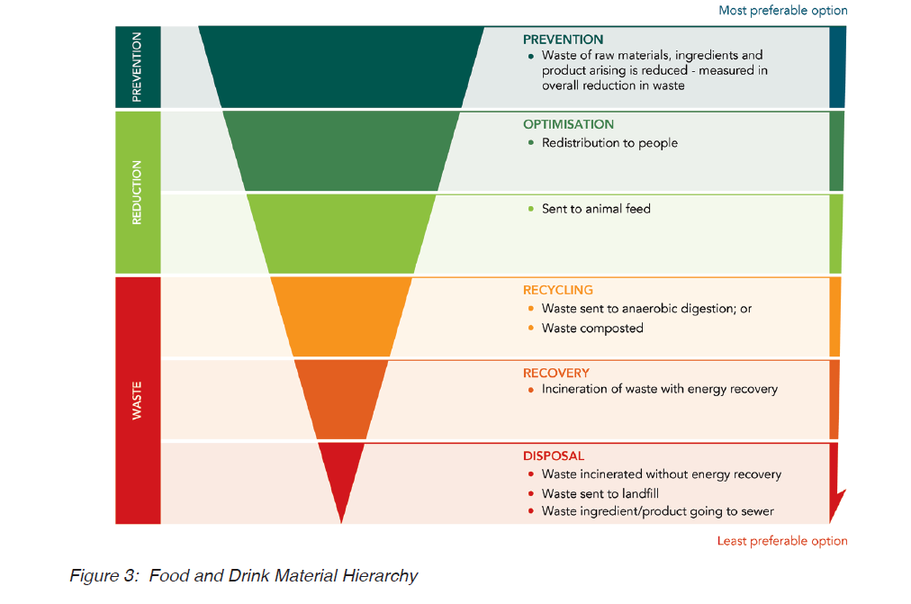
FOOD WASTE AND MATERIALS HIERARCHY

Slide 6
WHAT CAN CITIES DO TO PREVENT FOOD WASTE?
Quantification and characterisation of food waste
Engagement and reporting
Organisation - level initiatives
Regulatory initiatives
Raising awareness and communication policies
Notes:
Humans directly or indirectly generate over 105 billion tonnes of organic wastes globally each year, all of which release harmful methane and other greenhouse gas emissions directly into the atmosphere as they decompose. These organic wastes include food waste, sewage and garden wastes, food and drink processing wastes, and farm and agricultural wastes.
The WBA advocates for the collection of organic wastes and materials, and their treatment through technologies such as anaerobic digestion (AD), which turns them into renewable energy, bio-CO₂, natural fertilisers, and other valuable bio-products.
Today only 2% of these are treated and recycled. Over the first decade in the atmosphere, one tonne of methane is the equivalent of 86 tonnes of CO₂. If we do not cut methane emissions from organic wastes, then a climate catastrophe is unavoidable. Bodies such as the IEA and the European Commission have been strongly demanding more attention to the methane threat, with the EU having recently published its Methane Strategy. By managing all organic wastes as important bioresources through technologies such as AD for the generation of biogas, bio-fertilisers, bio-CO₂, and other valuable bio-products, we can cut global GHG emissions by 10% by 2030, starting now.

Slide 7
HOW CAN CITIES COLLECT FOOD WASTE SEPARATELY?
Auckland, New Zealand
Cajica, Colombia
Copenhagen, Denmark
Hartberg, Austria
Milan, Italy
Minneapolis, USA
New York, USA
Oslo, Norway
Seoul, South Korea
Notes:
Humans directly or indirectly generate over 105 billion tonnes of organic wastes globally each year, all of which release harmful methane and other greenhouse gas emissions directly into the atmosphere as they decompose. These organic wastes include food waste, sewage and garden wastes, food and drink processing wastes, and farm and agricultural wastes.
The WBA advocates for the collection of organic wastes and materials, and their treatment through technologies such as anaerobic digestion (AD), which turns them into renewable energy, bio-CO₂, natural fertilisers, and other valuable bio-products.
Today only 2% of these are treated and recycled. Over the first decade in the atmosphere, one tonne of methane is the equivalent of 86 tonnes of CO₂. If we do not cut methane emissions from organic wastes, then a climate catastrophe is unavoidable. Bodies such as the IEA and the European Commission have been strongly demanding more attention to the methane threat, with the EU having recently published its Methane Strategy. By managing all organic wastes as important bioresources through technologies such as AD for the generation of biogas, bio-fertilisers, bio-CO₂, and other valuable bio-products, we can cut global GHG emissions by 10% by 2030, starting now.

Slide 8
CAJICA, COLOMBIA
EPC and IBICOL have been running a door-to door organic waste collection programme since 2008.
The collection programme serves 25,000 houses and 88,000 inhabitants.
Organic waste collected in a plastic bucket with holes to drain liquid produced by accumulated waste
The bucket is pre-applied with effective microorganisms and a rice/wheat bran based material that aid the composting of the organic matter
Waste collected once a week and transported to a composting site
The education and involvement of residents identified as key
It reduced illegal dumping, raised public awareness about recycling and encouraged home growing of food

Slide 9
HOW CAN CITIES TREAT THE COLLECTED FOOD WASTE?
Notes:
Humans directly or indirectly generate over 105 billion tonnes of organic wastes globally each year, all of which release harmful methane and other greenhouse gas emissions directly into the atmosphere as they decompose. These organic wastes include food waste, sewage and garden wastes, food and drink processing wastes, and farm and agricultural wastes.
The WBA advocates for the collection of organic wastes and materials, and their treatment through technologies such as anaerobic digestion (AD), which turns them into renewable energy, bio-CO₂, natural fertilisers, and other valuable bio-products.
Today only 2% of these are treated and recycled. Over the first decade in the atmosphere, one tonne of methane is the equivalent of 86 tonnes of CO₂. If we do not cut methane emissions from organic wastes, then a climate catastrophe is unavoidable. Bodies such as the IEA and the European Commission have been strongly demanding more attention to the methane threat, with the EU having recently published its Methane Strategy. By managing all organic wastes as important bioresources through technologies such as AD for the generation of biogas, bio-fertilisers, bio-CO₂, and other valuable bio-products, we can cut global GHG emissions by 10% by 2030, starting now.

Slide 10
ANAEROBIC DIGESTION (AD)
Anaerobic Digestion (AD) recycles organic wastes into
Biogas
bio-CO2
natural fertilisers
and other valuable bio-products
By recycling the readily available organic wastes, we can cut global GHG emissions by 10% by 2030

Slide 11
WHAT CAN AD CONTRIBUTE?
AD is a key route to decarbonisation – Biogas helps to decarbonise the hardest-to-decarbonise sectors of waste management, agriculture, heat and transport
AD supports the UN Sustainable Developments Goals – helping achieve 9 of the 17 targets including clean water and sanitation and zero hunger
AD generates employment: 11-15 million jobs globally by 2030
Potential to generate green energy: 10,100 to 14,000 TWh
This energy can meet 6-9% of the world’s primary energy consumption
As biomethane, it can substitute 26-37% of today’s current natural gas consumption

Slide 12
PRODUCTS OF AD
Biogas cooking and lighting
Biogas boilers
Renewable electricity
Renewable heat
Biomethane (to grid or for use as a vehicle fuel)
Digestate/Compost
Carbon dioxide
Cooling

Slide 13
SETTING THE BAR HIGH!
Targets
Emission reduction
Renewable energy generation
Biogas based energy
Food waste prevention
Organic waste recycling
Diversion from landfills

Slide 14
POLICY OPTIONS TO SUPPORT THE TARGETS
Incentivise - Pricing GHG emissions
Provide financial security - Renewable Energy Incentives
Disincentivise - Pay As You Throw schemes
Require - Organics to landfill ban, Recycling requirements
Create markets - Digestate standards and certification
Lead the way - Capital Grants

Slide 15
4 ACTIONS CITIES CAN TAKE TODAY
Undertake large scale food waste awareness and prevention campaigns
Require businesses to separately collect food waste
Provide separate collection of food waste to households
Require disposal of food waste in line with the food and drink waste hierarchy

Slide 16
Charlotte Morton
Chief Executive
cmorton@worldbiogasassociation.org
www.worldbiogasassociation.org
World Biogas Association

